Slide 1
Health Economics
Chapter 22:
Comparative Health Care Systems and Health System Reform

Slide 2
Motivation
Compared to other industrialized countries, the US has high health expenditures but performs relatively poorly on health status measures.
 | US | Canada
Infant mortality rate (1998) | 7.5 | 6.6
Female/Male life expectancy (1998) | 79.4 / 73.9 | 81.7 / 76.3
Health expenditures as a % of GDP | 13.1 (2000) 16.0 (2007) | 9.2 (2000) 10.0 (2007)
Health expenditure per capita | $4,631 (2000) $7,290 (2007) | $2,535 (2000) $3,895 (2007)

Slide 3
Motivation
Most industrialized nations offer a more expansive national health care system
What can we learn? Can we get more bang for our buck?

Slide 4
Commonwealth Fund Report 2010
http://www.google.com/url?sa=t&source=web&cd=4&ved=0CCsQFjAD&url=http%3A%2F%2Fwww.commonwealthfund.org%2F~%2Fmedia%2FFiles%2FPublications%2FFund%2520Report%2F2010%2FJun%2F1400_Davis_Mirror_Mirror_on_the_wall_2010.pdf&ei=X0vGTIHzGsSBlAfc48G-Ag&usg=AFQjCNEZJM-iBmMWumdd2xSp7kDenyQqZw&sig2=Ey0QYo94n5lIBkSFX_3l5Q
The United States ranked last when compared to six other countries -- Britain, Canada, Germany, Netherlands, Australia and New Zealand
Report uses data from nationally representative patient and physician surveys in seven countries in 2007, 2008, and 2009

Slide 5
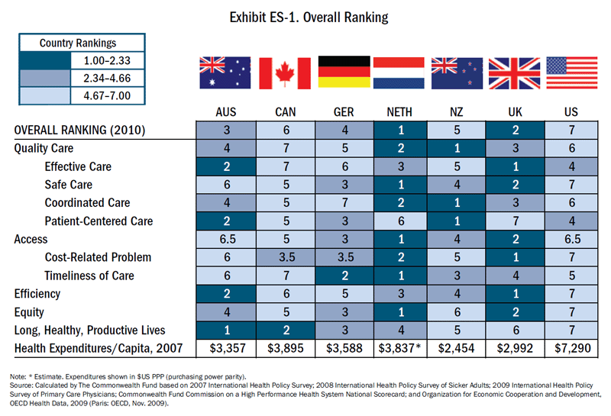

Slide 6
Comparison
Britain, whose nationalized healthcare system was widely derided by opponents of U.S. healthcare reform, ranks first in quality
The Netherlands ranked first overall on all scores
U.S. patients with chronic conditions were the most likely to say they gotten the wrong drug or had to wait to learn of abnormal test results

Slide 7
But is it all about the bad U.S. lifestyle?
Europeans or Australians live healthier lifestyles than Americans (i.e. high rates of obesity in U.S.)
BUT: “…, the other countries have higher rates of smoking"
Germany, for instance, has a much older population more prone to chronic disease
Every other system covers all its citizens, the U.S. system, which leaves 46 million Americans or 15 percent of the population without health insurance, is the most unfair. (Is this true??)
"The lower the performance score for equity, the lower the performance on other measures. This suggests that, when a country fails to meet the needs of the most vulnerable, it also fails to meet the needs of the average citizen," the report reads.

Slide 8
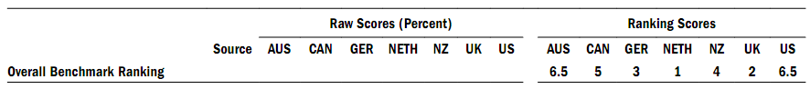
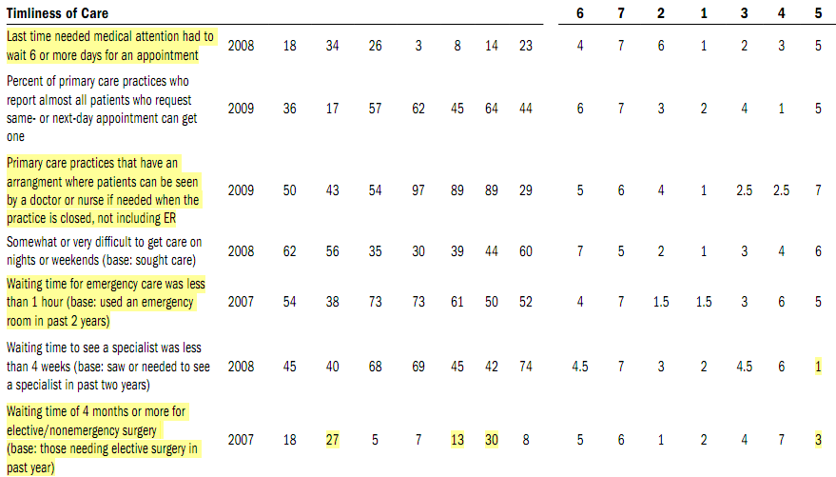

Slide 9
A Typology of Health Care Systems
National health care (provided by the state)
Denmark, UK, Turkey, Italy, New Zealand
Community sickness funds with a state subsidy
Austria, Belgium, France, Germany
National health insurance
Canada, Finland, Norway, Spain, and Sweden
Mixed systems
US, Australia, Iceland, Japan, Netherlands

Slide 10
US Health Issues
Spend the most on health care but perform poorly on measures of health status relative to other industrialized countries.
Employer-based insurance
Leaves a large portion of population uninsured (49 million in 2007)
Contributes to frictions in labor markets
Job lock
“Late” Retirement
Companies complain that health care costs are crippling their ability to compete, especially internationally.

Slide 11
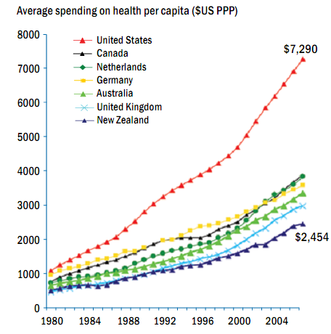

Slide 12
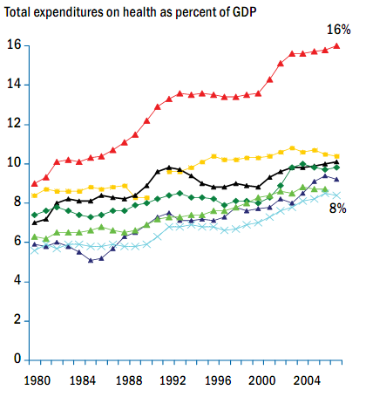
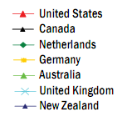

Slide 13
Outline
We will investigate some details of the following countries:
United Kingdom
Germany
Canada
South Korea
We will then discuss how universal health insurance could affect health care delivery in the US.

Slide 14
United Kingdom
Type of system
National Health Service (NHS), formed at the end of WWII
Basic Structure
Financed largely through general revenues
Free physician visits and hospital procedures; some copayments for pharmaceuticals, dental care, and eyeglasses.
About 10% of Britons have private health insurance to cover additional services
General practitioners act as gatekeepers and contract with the gov’t
Hospital physicians are paid by the state on a salaried basis; office-based physicians are paid on a capitation basis.
Rationing → waiting lists

Slide 15
United Kingdom
Access
Long waiting lists for specialty care
Limit on availability of new technology
Performance
Female/male life expectancy: 79.4 / 74.6 (U.S. 79.4 / 73.9)
infant mortality rate: 8.4 per 1000 births (U.S. 7.5)
Cost
Per capita expenditures: 8.3% of GDP in 2004
Much lower than U.S. (15.3% in 2004)

Slide 16
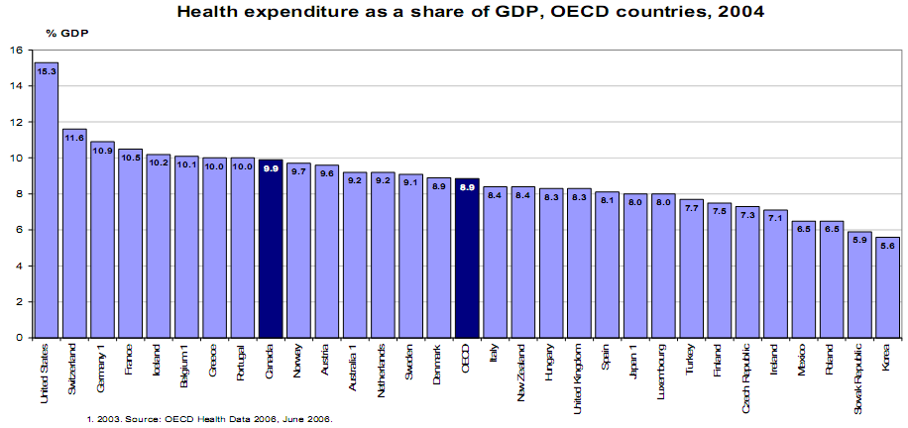

Slide 17
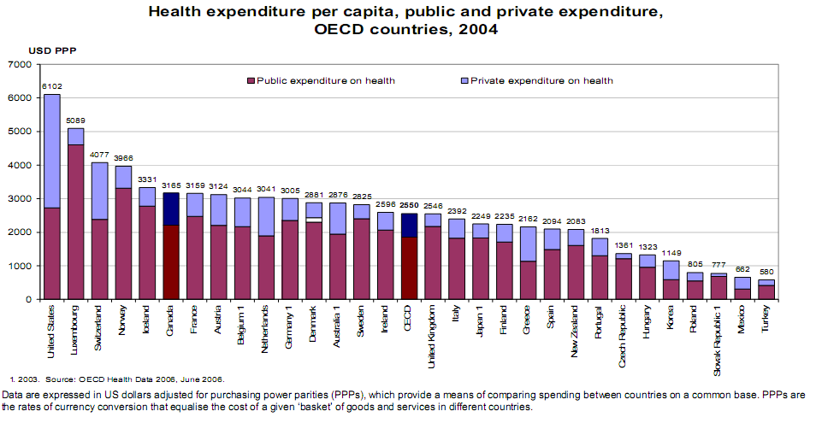

Slide 18
Additional issues
Purchaser/provider split
Quasi-market reform (fundholders)
Incentive issues
NHS providers may work in private sector if they work less than a prescribed amount with NHS
Providers are paid a salary with NHS and fee-for-service in private sector
The longest NHS waiting lists occur in specialties in which specialists have the highest private earnings

Slide 19
Germany
Type of system
Private insurance with a state subsidy, first created under Bismark (1870-1890).
Basic Structure
Universal care through mandatory enrollment unless income is above a certain threshold
Funded through payroll taxes
92% have social insurance
About 400 independent localized plans called sickness funds (Krankenkassen). These are non-profit institutions organized at the workplace, occupation, or union level.
The plans are required to provide a minimum level of care.
The government subsidy is capped at a predetermined level, which gives funds the incentive to hold costs down.

Slide 20
Germany
Access
Long lines have largely been avoided
Performance
Female/male life expectancy: 80.5 / 74.5 (U.S. 79.4 / 73.9)
infant mortality rate: 6.2 (U.S. 7.5)
Cost
Per capita expenditures: 10.9% of GDP in 2004
Lower than U.S. (15.3% in 2004)

Slide 21
Additional Issues
The system is similar to the US’s in many respects
Many autonomous insurers
Over-emphasis on high-tech care at the expense of preventive and long-term care
Prospective payment system (PPS) to hospitals based on Diagnosis Related Groups (DRGs) and not on length of hospital stay (days in hospital).
The major difference seems to be universal coverage
Adverse selection alleviated!!
A culture of health? Many more services are covered by insurance.

Slide 22
Oh, Canada!
Type of system
National Health Insurance (called Medicare)
Basic Structure
Each province (10) and territory (3) has a plan with cost sharing from the federal government
The regional plans must meet basic accessibility requirements
Universal, comprehensive, and portable
Private funds still account for 1/3 of overall spending because certain services are not covered (most notably prescription drugs)
However, provinces provide coverage to seniors, children, and people on social assistance programs that includes prescription drugs, dental- and vision care, etc.

Slide 23
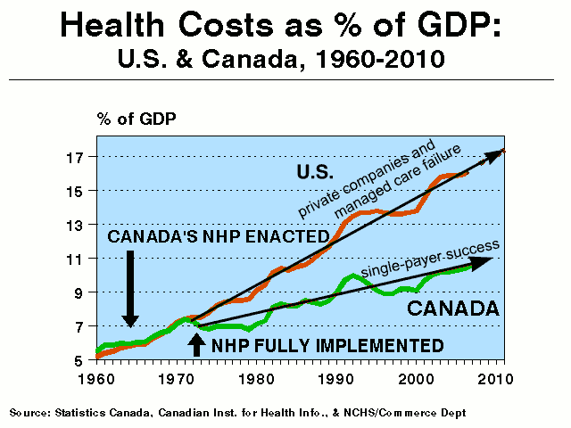

Slide 24
Canada
Most physicians are in private practice and have hospital admitting privileges (different from Britain’s NHS)
Doctors are paid FFS
Hospitals are private, but largely funded by provinces
Since 1972 every province has provided universal coverage for hospital and physician care
Physician-population ratio is 12% lower than U.S.
Nurse ratio level is 27% higher
Lower fees in Canada (salaries of doctors, price of procedures etc.) but higher volume of care (Fuchs and Hahn 1990)
Cost control (cap on fees etc.) -> supply side control, keeps costs lower than in the U.S.

Slide 25
Canada
Administrative costs
In 1987, admin expenses were approximately $300 more per capita in the U.S. than in Canada.
In 1999 the U.S. spent $752 more per capita
Administration costs: U.S. spends 31 percent of total health expenditures, Canada 16.7 percent.
U.S. spends 80 percent more per capita on health care (2002)
Not all is happy in Canada
Concern over paying for the system in tougher economic times with federal deficits
Time rationing as in the UK but without a readily available alternative (Canadians cannot “pay more” to get extra care like in the U.K.)
Waiting times are longer

Slide 26
Waiting Times for Knee-Replacement Surgery in the United States and Ontario
Peter C. Coyte, James G. Wright, Gillian A. Hawker, Claire Bombardier, Robert S. Dittus, John E. Paul, Deborah A. Freund, and Elsa Ho in The New England Journal of Medicine, 1994
http://healthpolicyandreform.nejm.org/?p=10954|
Random sample of 1,486 Medicare recipients (629 from the U.S. national sample and 516 people from Ontario who had been hospitalized for knee replacement between 1985 and 1989.
The median waiting time for an initial orthopedic consultation was 2 weeks in the United States and 4 weeks in Ontario.

Slide 27
Waiting Times for Knee-Replacement
The median waiting time for knee replacement after the operation had been planned was 3 weeks in the United States and 8 weeks in Canada.
In the US, 95 percent of patients considered their waiting time for surgery acceptable, as compared with 85.1 percent in Ontario.
Overall satisfaction with surgery ("very or somewhat satisfied") was 85.3 percent for all U.S. respondents and 83.5 percent for Canadian respondents.

Slide 28
South Korea
Type of system: Mixed
Basic Structure
SOUTH KOREA achieved universal health insurance in 12 years
Before 1977, Korea had only voluntary health insurance
1977 mandate for medical insurance for employees and their dependents in large firms (>500 employees)
1989, national health insurance (NHI) extended to the whole nation
NHI was financially stable from 1990 to 1995
Economic crisis of 1997 throughout southeast Asia, Korean NHI began to run a financial deficit.

Slide 29
South Korea
Other groups covered under a different plan
Low-income people covered by a Medicaid type program
Over 350 insurance firms
High coinsurance rates:
20% for hospital inpatient care
20 - 55% for outpatient care

Slide 30
South Korea
Cost containment
Relies mainly on fee controls (supply side measure) and high coinsurance rates (demand side measure)
Providers are paid fixed fees for any service
Performance
Female/male life expectancy: 78.1 / 70.6 (U.S. 79.4 / 73.9)
infant mortality rate: 9 (U.S. 7.5)
Cost
Per capita expenditures: 5.6% of GDP in 2004
Way lower than U.S. (15.5% of GDP in 2004)

Slide 31
Korea - Lessons for US?
Details of the plan matter
Korea transitioned to higher copayments in 1986 for physician visits
Lowered probability of physician visit
Increased services per visit
No overall reduction in spending!!
Nice example of transition to employment-based insurance – 12 years to achieve universal coverage
The multiple insurance firms (350+) proved unworkable
Limited ability to pool risk (adverse selection)
Korea moved to a national health insurance program in 2000!!

Slide 32
Health Status Comparison

Slide 33
Obesity
BMI = kg/m^2
BMI = pounds/inches^2*703
BMI > 25 = overweight
BMI > 30 = obese

Slide 34
Lincoln University, PA
Lincoln University requires overweight students to take fitness course to graduate
The mandate, which took effect for freshmen entering in fall 2006, requires students to get tested for their body mass index, a measure of weight to height.
A normal BMI is between 18.5 and 24.9. Students with one that's 30 or above -- considered obese -- are required to take a class called "Fitness for Life," which meets three hours a week.

Slide 35
Lincoln University, PA
The course involves walking, aerobics, weight training and other physical activities, as well as information on nutrition, stress and sleep
About 15 percent of the entering freshman class in 2006 tested above the 30 BMI mark.

Slide 37
Have you ever seen a Canadian pack of cigarettes?

Slide 38
Canada and Cigarettes
Since December 20, 2000, cigarettes sold in Canada must display warnings which take up 50% of the principal display space.
One side is an English warning, the other is in French (the two official languages of Canada).

Slide 39
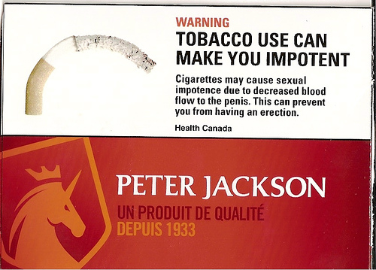

Slide 40
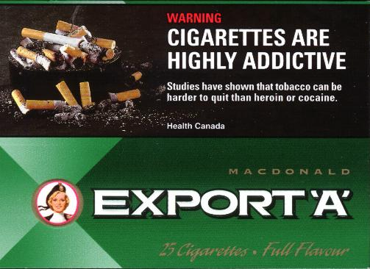

Slide 41
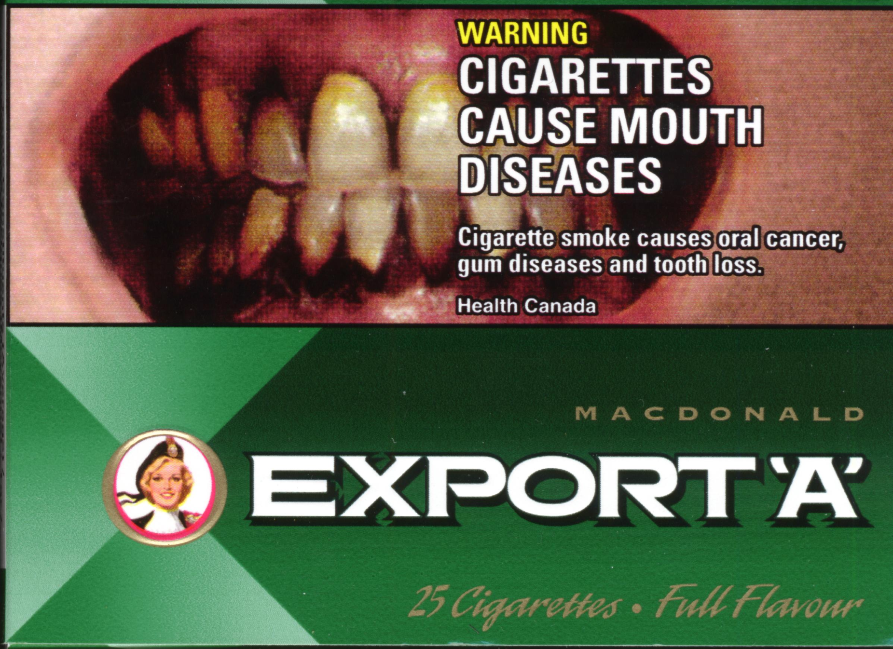

Slide 42
Negative Ad Campaigns
Hammond et al. (2004): http://www.ajph.org/cgi/reprint/94/8/1442
found that images on cigarette package elicited negative emotions and sales declined.
Graphic warnings have been criticized on 4 general grounds:
they will cause unnecessary or excessive emotional distress;
smokers will simply avoid the warnings;
graphic labels will under-mine the credibility of the message; and,
graphic or “grotesque” labels will cause reactance, or increases in consumption,
But the study disproves this criticism!!

Slide 43
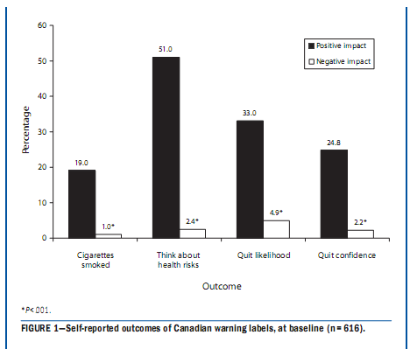
Source: Hammond et al. (2008)

Slide 44
Negative Ad Campaign
The Canadian warning labels have elicited strong emotional reactions from smokers.
Negative emotional reactions were associated with greater effectiveness of the warning labels.
Smokers who reported greater fear and disgust were more likely to
either have quit,
made an attempt to quit, or
reduced their smoking at follow-up.

Slide 46
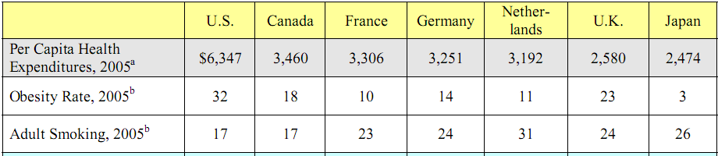
Health Comparisons
Source: Garber and Skinner (2008)

Slide 47
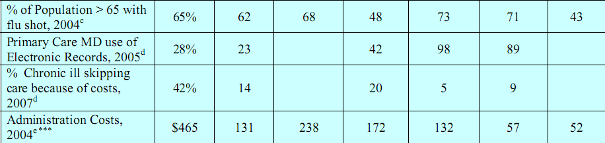
Health Comparisons
Source: Garber and Skinner (2008)

Slide 48
Electronic Health Records?

Slide 49
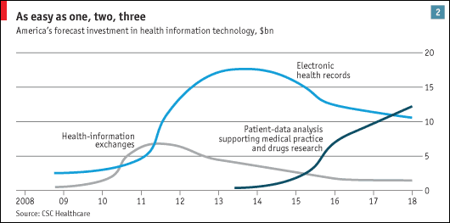
Electronic Health Care Reform
RAND Study from 2005.

Slide 50
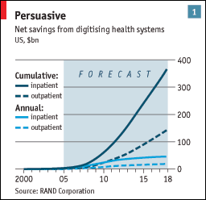
Digitization of Health Records
RAND Study from 2005.

Slide 51
Cost Savings from Health Information Technology (HIT)?
RAND Study: if 90% of hospitals and doctors in America were to adopt HIT over 15 years, the health system could save some $77 billion a year from efficiency increases
Incl. health-and-safety benefits, gains could double, saving about 6% of the $2.6 trillion of U.S. health care spending in 2009
Archives of Internal Medicine (2009)
HIT hospitals suffered 15% fewer deaths and
16% fewer complications, as well as enjoying lower costs.

Slide 52
Cost Savings from HIT?
Kaiser Permanente
unusual American health-care chain whose 8.6m patients receive fully integrated care, similar to Britain’s National Health Service (NHS)
Easier to implement an ambitious HIT system costing over $4 billion, top down implementation. “100% compliance” from doctors.
Health Affairs (2009): Kaiser showed HIT have cut visits per patient by an average of 26%, thanks to more e-mail and telephone consultations.
That saves money and increases efficiency, AND patients seem to like it too.

Slide 53
Cost Savings from HIT?
Reforms have been tried and failed repeatedly over the past 20 years.
One stumbling block has been privacy
technical tools to safeguard privacy, such as encryption software, have improved so much that this should no longer be a problem
Recent legal changes
A law passed in America last year stops insurers or employers from using genetic information as a basis for discrimination

Slide 54
Cost Savings from HIT?
A bigger obstacle has been resistance from doctors
some of which stems from failed previous efforts to introduce HIT
Doctors and nurses have too often been required to learn how to use new software but have rarely been compensated for their time or seen tangible medical benefits.
Fiscal-stimulus package includes nearly $20 billion to create a national health-information network, including incentives for hospitals and doctors to adopt EHRs.

Slide 55
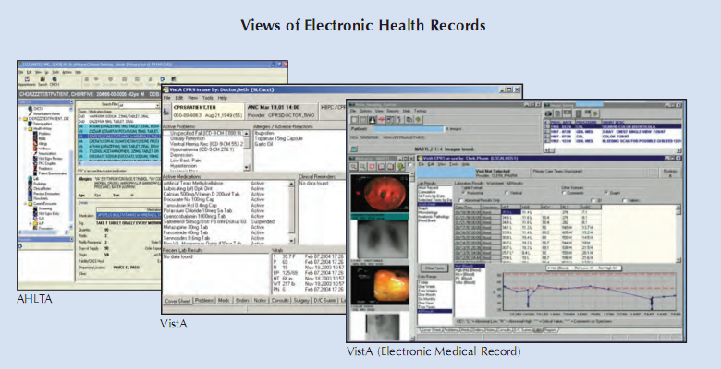
The V.A.’s Electronic System

Slide 56


Slide 57
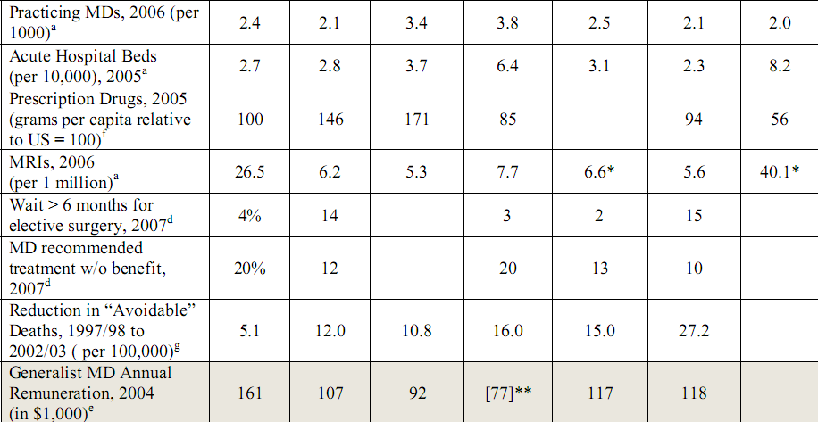
Health Comparisons
Source: Garber and Skinner (2008)

Slide 58
Improvements in Treatment of Heart Disease
Ford et al. (2007) decomposed the reduction in mortality rates due to heart disease:
61% of decline were explained by health behaviors that are not directly associated with health care (e.g. reductions in cholesterol)
20% low-cost off-patent drugs (e.g. aspirin, beta-blockers, anti-hypertensives)
13% medium tech (e.g. more expensive drugs)
Only 7% due to hi-tech (e.g. cardiac bypass surgery, angioplasty, and stents)

Slide 59
Is American Health Care Uniquely Inefficient Garber and Skinner (2008)
1970 U.S. spent 40% more than peer countries
2004 U.S. spent 90% more than peer countries
Explanations for high health expenditure:
Defensive medicine due to litigation
Diffusion and adoption of new technology (e.g. reimbursement rates are based on average costs that include the high fixed costs of installation of expensive machines)
Higher prices due to higher doctor salaries and newer (more efficient??) drugs
Incentives for doctors to use expensive MRI scans (e.g. paid per scan – 10% growth rate in recent years in MRI and computer tomography scans (CT or CAT scans))
Higher admin costs (31% of health spending, vs. Canada’s 16.7%)
Lifestyle (high obesity rates)

Slide 60
Is American Health Care Uniquely Inefficient Garber and Skinner (2008)
Claim: U.S. has lower health production function
How can we fix it?
Reduce unequal care
Push for electronic health records to improve productive efficiency
Use cheaper drugs (i.e. highly effective low cost drugs)

Slide 61
Is American Health Care Uniquely Inefficient Garber and Skinner (2008)
Most reforms that improve productive efficiency (like electronic health records) are unlikely to have a large impact in reducing expenditures
CBO, 2008 on the effects of electronic records;
Improvements: yes.
Solution to cost explosion? Not really.
Compare to RAND study results earlier.

Slide 62
Productive vs. allocative efficiency
Productive (or technical) efficiency describes the situation when all factors of production (health inputs) are used in their most efficient way, so that the economy produces on the production frontier.
Use a fixed mix of resources efficiently to produce the most outcome.
Reasons for technical inefficiency:
Misuse of workers or machines
Not working at full capacity
Not cooperating well (e.g. electronic health records might alleviated this)

Slide 63
Productive vs. allocative efficiency
Allocative efficiency is concerned with producing the right amount of health vs. all other consumption goods.
Allocative efficiency: Use the right mix of resources to produce the most outcome.
We then compare the marginal utility of an extra unit of health with the marginal utility of an extra unit of a consumption good.
Reasons for allocative inefficiency:
Use too much capital (e.g. too concentrated on high tech, MRI scanners etc.), or
Use too much labor (e.g. specialist doctors instead of general practitioners or nurses)

Slide 64
Garber and Skinner (2008)
Expansion of health insurance coverage to improve productive efficiency.
Unlikely to reduce expenditures
U.S. typically does not consider effectiveness relative to its costs or to the costs of alternative treatments due to public indifference and political barriers,
e.g. Garber (2004) and Neumann (2005)

Slide 65
Is American Health Care Uniquely Inefficient Garber and Skinner (2008)
High deductible health insurance,
designed to limit moral hazard, can have paradoxical effect of reducing consumption of highly cost-effective treatments, such as hypertension treatments.
This reduces productive efficiency.
Pay for outcomes, rather than inputs.

